Slide 1


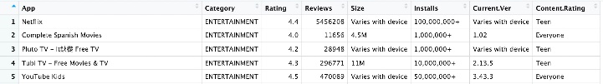

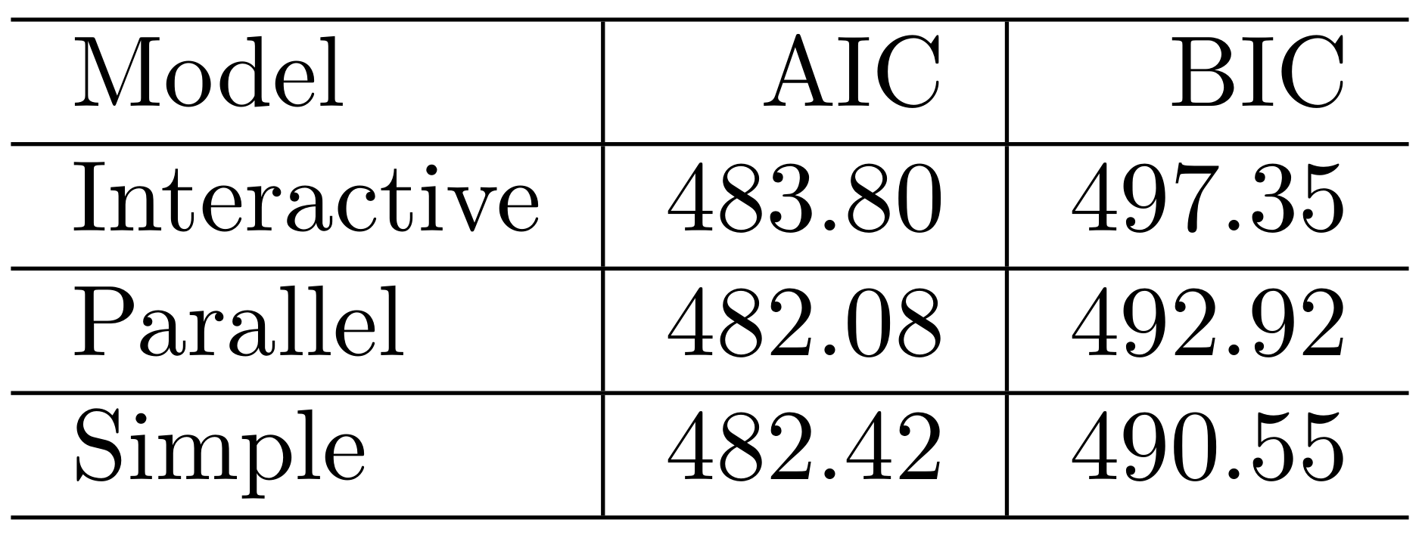
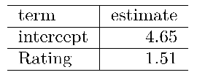

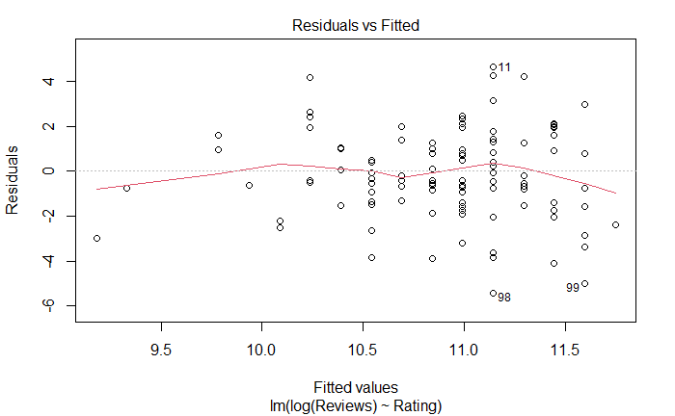
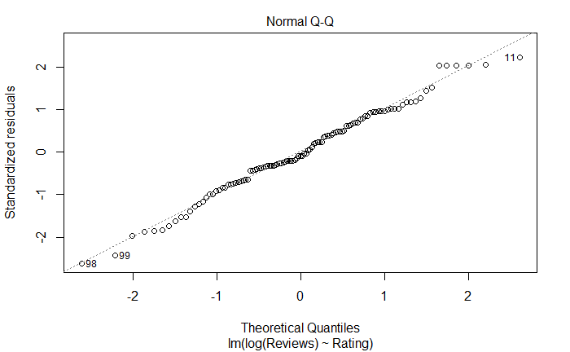
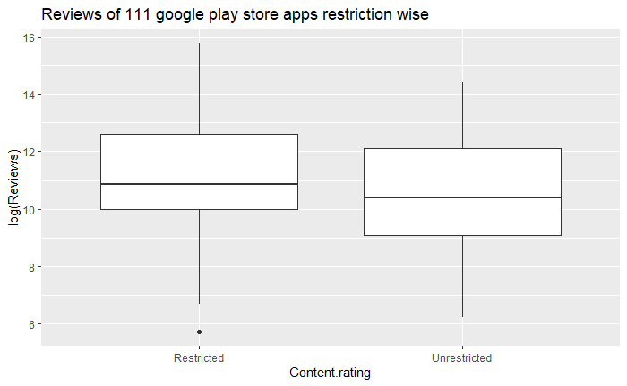
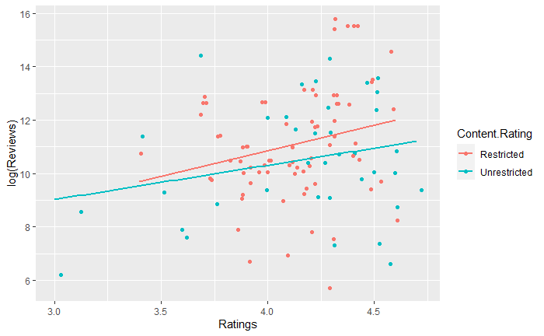

Research on the Explanatory Variables of Entertainment Applications’ Reviews
Group 4: Qing Zhang, Suraj Kumar, Xin Zhang, Xinyue Shu, Yao Xiao
School of Mathematics and Statistics, University of Glasgow, UK
Introduction
Formal Data Analysis
A large number of entertainment applications exist in the Google Play. To study the influencing factors of the reviews, this analysis selected 111 entertainment applications from Google Play as the observations, Reviews as response variable, Rating as explanatory variable, and Content.Rating as a categorical explanatory variable. After cleaning data, we get the tidy data as below.
Table 1. First five rows of data
Model 1 (different slopes):
log(Reviews) ~ Rating * Content.Rating
Model 2 (parallel lines):
log(Reviews) ~ Rating + Content.Rating
Model 3 (single line):
log(Reviews) ~ Rating
By comparing 3 models, model 2 and model 3 have comparable and lower AIC than model 1. Model 3 has lowest BIC value, so we accept model 3 and reject the interactive model (model1) and parallel model (model 2). We obtain the regression equation:
log(Reviews) = 4.65+1.51*Rating
Table 3. Confirmation of model.
Additionally, we plot residuals vs fitted value and normal Q-Q plot to verify the standard assumptions of linear regression. In our case, there is no pattern observed in residual plot and normal Q-Q plot perfectly fits the diagonal line. Therefore, the residuals have mean 0, constant variance, and are normally distributed.
Figure 3. Residual distribution
Add your information, graphs and images to this section.
Add your information, graphs and images to this section.
Exploratory Data Analysis
Table 2 shows the summary statistics on the content rating and ratings of 111 applications, among them, 74 applications are restricted and 37 unrestricted. In general, there is no significant difference between restricted and unrestricted applications. The average ratings of restricted and unrestricted applications are close (4.12 and 4.16 respectively). However, unrestricted application ratings have wider spread.
Table 2. Summary on Rating by Content Rating of 111 observations.
From the boxplot, we can see there is no significant difference in median log(reviews) between Restricted and Unrestricted, and only one potential outlier in unrestricted cases.
From the scatter, we can see there is a weak positive relationship between Ratings and log(Reviews) in both categories and slopes of two categories are almost the same.
Figure 2. Boxplot and scatter plot
Add your information, graphs and images to this section.
Conclusion
There is a simple linear positive relation between log(Reviews) and Rating. For each point increase in Rating, log(Reviews) will increase by approximately 1.5105.
There is no significant interactive relationship between Content rating and log(Reviews).
The conclusion goes with the initial impression.
Reference
Future Perspectives
Gupta, L. (2019). Google Play Store Apps. Retrieved from https://www.kaggle.com/lava18/google-play-store-apps/download
Arrows, K. (2020). Google Play Games icon [Photograph]. Retrieved from https://appuals.com/how-to-edit-your-google-play-games-profile/
Chua, O. (2015). YouTube Kids Logo [Photograph]. Retrieved from http://www.onrychua.com/2015/02/youtube-finally-release-kid-friendly.html#more
Mac, M. (2009). HQ iPhone App Style logo for the BBC iPlayer [Photograph]. Retrieved from http://www.userlogos.org/logo/macleodmac/03212009/bbccoukiplayer
We will increase the amount of observations and categories of applications.
We will consider and analyse the influence of reviews content.
We will find out more explanatory variables of log(Reviews).

